Slide 1
Wallace tree
Multiplication of two 8-bit integers A x B = P, where P is the 16-bit product.
P = P0+P1+P2+P3+P4+P5+P6+P7
[x is the arithmetic multiply and + is the arithmetic add]
 |  |  |  |  |  |  |  | 1 | 0 | 1 | 1 | 0 | 1 | 0 | 1
 |  |  |  |  |  |  |  | 1 | 0 | 0 | 1 | 0 | 0 | 1 | 1
 |  |  |  |  |  |  |  | 1 | 0 | 1 | 1 | 0 | 1 | 0 | 1
 |  |  |  |  |  |  | 1 | 0 | 1 | 1 | 0 | 1 | 0 | 1 | 0
 |  |  |  |  |  | 0 | 0 | 0 | 0 | 0 | 0 | 0 | 0 | 0 | 0
 |  |  |  |  | 0 | 0 | 0 | 0 | 0 | 0 | 0 | 0 | 0 | 0 | 0
 |  |  |  | 1 | 0 | 1 | 1 | 0 | 1 | 0 | 1 | 0 | 0 | 0 | 0
 |  |  | 0 | 0 | 0 | 0 | 0 | 0 | 0 | 0 | 0 | 0 | 0 | 0 | 0
 |  | 0 | 0 | 0 | 0 | 0 | 0 | 0 | 0 | 0 | 0 | 0 | 0 | 0 | 0
 | 1 | 0 | 1 | 1 | 0 | 1 | 0 | 1 | 0 | 0 | 0 | 0 | 0 | 0 | 0
0 | 1 | 1 | 0 | 0 | 1 | 1 | 1 | 1 | 1 | 1 | 0 | 1 | 1 | 1 | 1
A=
B=
Partial product Pj is obtained by multiplying the multiplicand A by the j^{th} bit of the multiplier B and then shifting the result by j bits to the left for j = 0,1,2,3,4,5,6,7.
Pj is (8+j) bits long with j trailing zeros.
Summation of the eight partial products is done with a Wallace tree of CSAs plus a CPA at the final stage.
P=

Slide 2
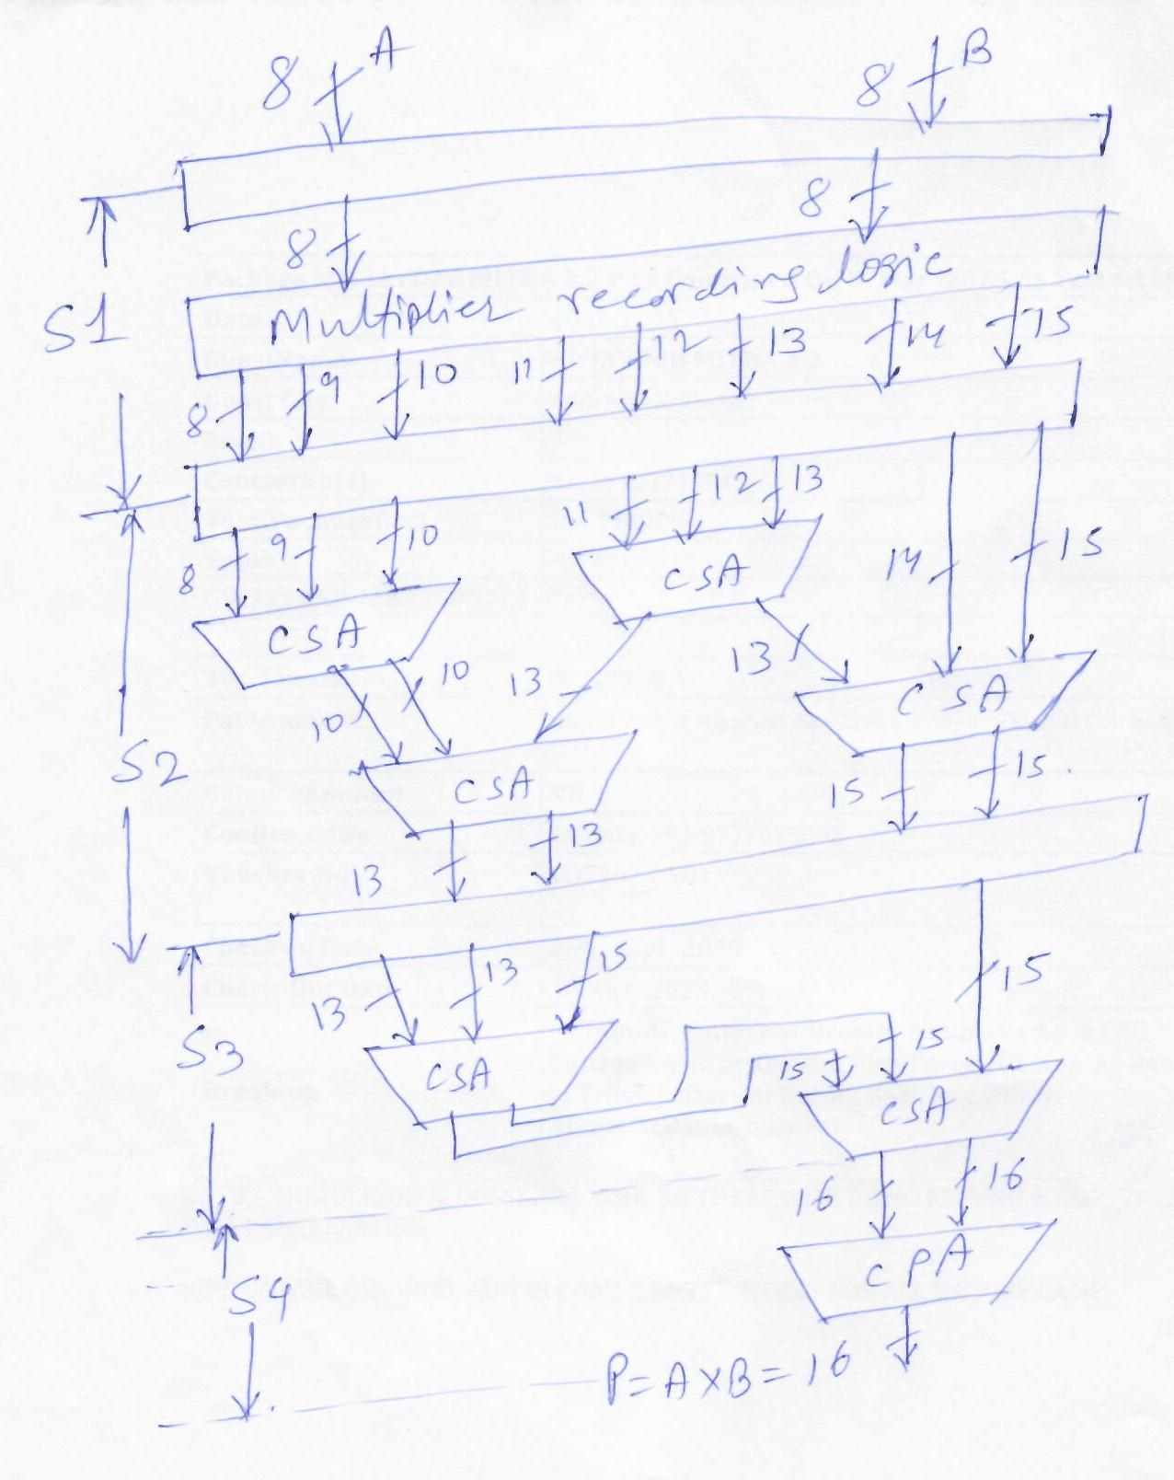
S1 generates all 8 partial products, ranging from 8 bits to 15 bits simultaneously
S2, made up of two levels of 4 CSAs, which essentially merges 8 numbers into 4 numbers ranging from 13 to 15 bits
S3 consists of two CSAs, which merges 4 numbers into two 16 bits numbers
S4, final stage to add the last two numbers to produce the final product P

Slide 3
Bit pair multiplication
Booth’s algorithm has two attractive features
Useful for positive and negative multipliers uniformly
Improves speed of operation or efficiency by reducing the number of arithmetic operations depending on the multiplier type
Bit pair recording of multiplier reduces the maximum number of operations (partial product) and hence improves speed.
Multiplier bit pair | Multiplier bit on the right | Booth’s |  | Bit pair
i+1 i | i-1 |  |  | Multiplicand selected at position i
0 0 | 0 | 0 0 | 0x2¹ + 0x2⁰ | 0 x M
0 0 | 1 | 0 +1 | 0x2¹ + 1x2⁰ | +1 x M
0 1 | 0 | +1 -1 | 1x2¹ - 1x2⁰ | +1 x M
0 1 | 1 | +1 0 | +1x2¹ + 0x2⁰ | +2 x M
1 0 | 0 | -1 0 | -1x2¹ + 0x2⁰ | -2 x M
1 0 | 1 | -1 +1 | -1x2¹ + 1x2⁰ | -1 x M
1 1 | 0 | 0 -1 | 0x2¹ - 1x2⁰ | -1 x M
1 1 | 1 | 0 0 | 0x2¹ + 0x2⁰ | 0 x M

